Slide 1
Geometry All you need is a pencil!
Subtitle

Slide 2
Objective
BTEOTPSWBAT:
Prove two triangles are congruent without having to list all 3 sets of corresponding sides congruent and all 3 sets of corresponding angles congruent
Use the VAT, Reflexive Property, and other definitions previously learned to identify congruent parts of triangles.

Slide 3
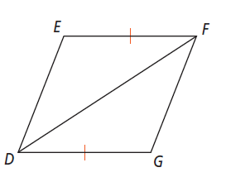
4-2 Triangle Congruence by SSS and SAS Notes
1) What angle is included between $\overline{ED}$ and $\overline{EF}$?_____
2) Which sides include ∠G? ______________
3) Which sides include $∠GDF?$ ___________
4) What is a non-included side for ∠E? ___________
5) What are the two non-included angles for $\overline{ED}$ and $\overline{DF}$? _________

Slide 6
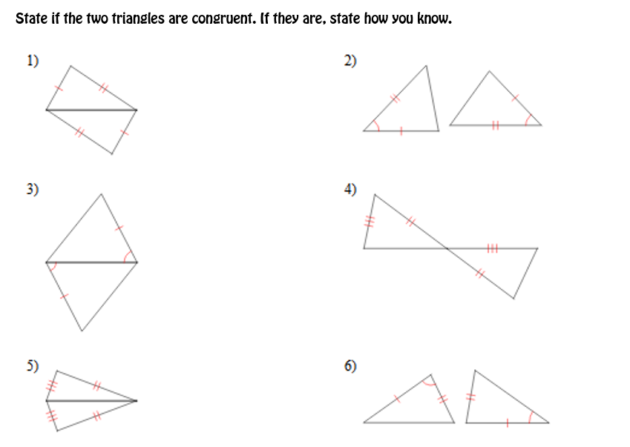

Slide 7
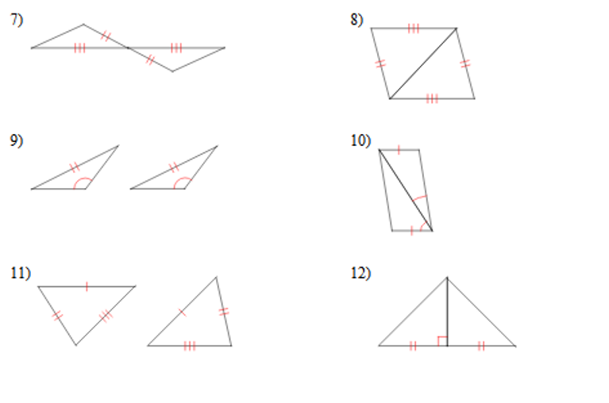

Slide 8
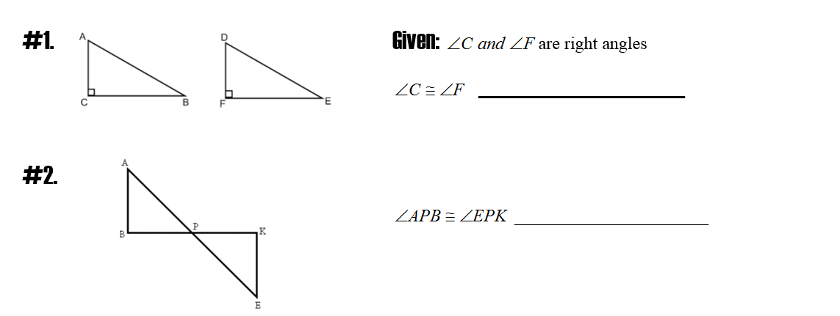
Common ways to prove angles congruent

Slide 9
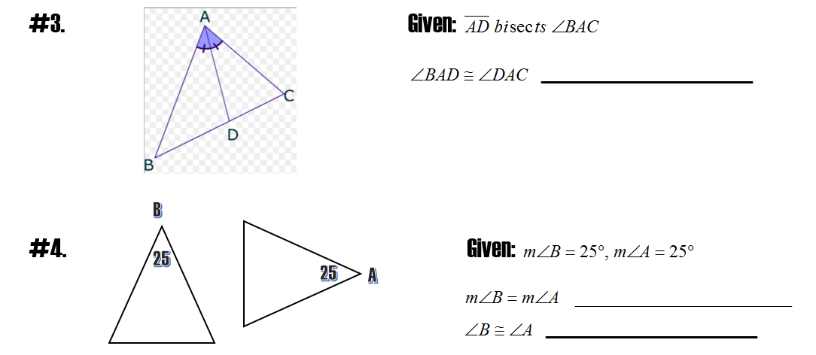
Common ways to prove angles congruent

Slide 10
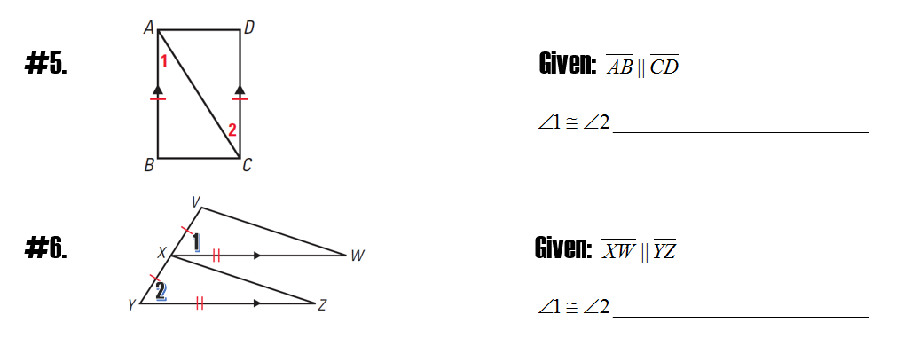
Common ways to prove angles congruent

Slide 11
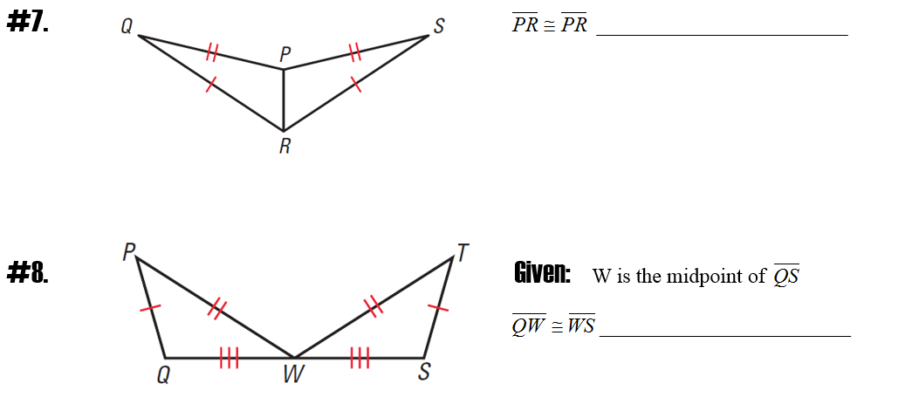
Common ways to prove segments congruent

Slide 12
Common ways to prove segments congruent

Slide 13
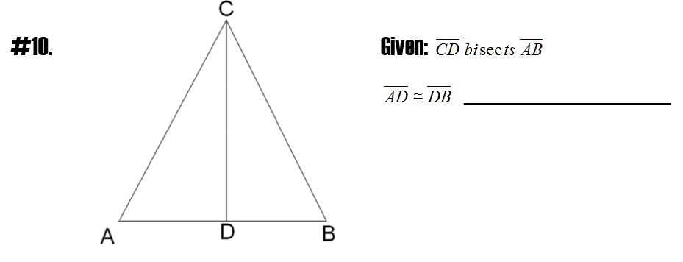
Common ways to prove segments congruent

Slide 17
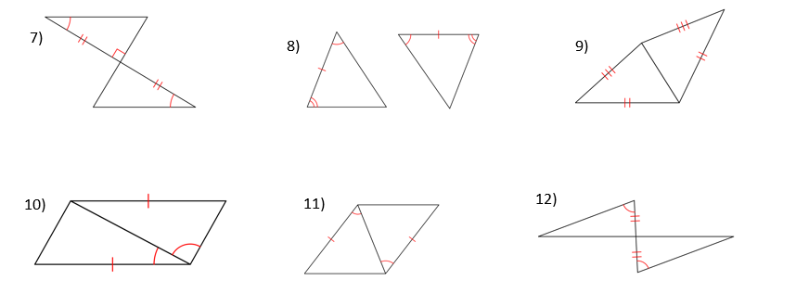

Slide 18
