Slide 1
Geometry Thurs/Fri Nov 8/9
Subtitle

Slide 2
Agenda
Go over Test
Notes on 4.1
Practice
Homework

Slide 9
Objectives
By the end of the period, students will be able to:
Write a correct congruence statement for triangles
Mark information in a picture, given the congruence statement
Write the corresponding side or angle given a picture or a congruence statement
Use the Third Angle Theorem to solve for a missing angle, or to prove triangles congruent

Slide 10
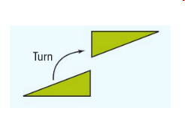
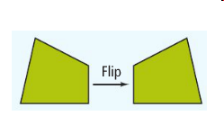
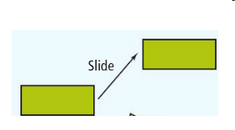

Slide 11
In two congruent figures, all the parts of one figure are congruent to the corresponding parts of the other figure. In congruent polygons, this means that the corresponding sides and the corresponding angles are congruent.

Slide 13
List all congruent corresponding parts if
TIP: You don’t need a picture if you have the Congruence Statement
Corresponding
∠s are ≅
Corresponding
sides are ≅
Iff
Polygons are ≅

Slide 14
Practice with Congruence Statements
Corresponding Sides:$\overline{SU}≅\overline{ZY}$; $\overline{UT}≅\overline{YX}$; $\overline{TS}≅\overline{XZ}$;
Corresponding Angles:$∠S≅∠Z$; $∠U≅∠Y$; $∠T≅∠$X;
Congruence Statement: $∆SUT≅∆ZYX$

Slide 15
Practice with Congruence Statements
Corresponding Sides:$\overline{VC}≅\overline{VW}$; $\overline{CB}≅\overline{WX}$; $\overline{BV}≅\overline{XV}$;
Corresponding Angles:$∠XVW≅∠BVC$; $∠C≅∠W$;
$∠X≅∠B$;
Congruence Statement: $∆XVW≅∆BVC$

Slide 16
Practice with Congruence Statements
Corresponding Sides:$\overline{LM}≅\overline{FG}$; $\overline{MN}≅\overline{GH}$; $\overline{NL}≅\overline{HF}$;
Corresponding Angles:$∠L≅∠F$; $∠M≅∠G$; $∠N≅∠$H;
Congruence Statement: $∆LMN≅∆FGH$

Slide 17
Practice with Congruence Statements
Corresponding Sides:$\overline{QR}≅\overline{LJ}$; $\overline{RS}≅\overline{LS}$; $\overline{SQ}≅\overline{SJ}$;
Corresponding Angles:$∠Q≅∠J$; $∠R≅∠L$; $∠QSR≅∠JSL$;
Congruence Statement: $∆RSQ≅∆LSJ$

Slide 18
Example 1 : Finding Congruent Parts
If BCA≅ DCA, name the congruent corresponding parts?
B
$\overline{BC}$ ≅ $\overline{DC}$
Sides:
$\overline{CA}$ ≅ $\overline{CA}$
C
$\overline{BA}$ ≅ $\overline{DA}$
A
D
Angles:
∠B ≅ ∠D
∠BCA ≅ ∠DCA
← If 2 ∠s share a vertex, use 3 letters to name them!
∠BAC ≅ ∠DAC

Slide 19
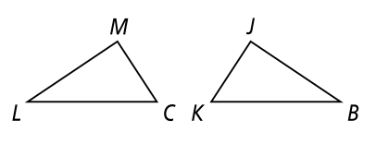
YOU TRY!
TIP: Match each part & write the measure on the other triangle!
10
50°
10
50°
44°
?
44°
9
9
44
+50
94
180
-94
86
△LMC ≅ △BJK. Complete the congruence statements.
1) $\overline{LC}$ ≅ ? 2) $\overline{KJ}$ ≅ ? 3) ∠L ≅ ?
∠M ≅ ? 5) △CML ≅ ? 6) △KBJ ≅ ?
If ML = 10, KB = 9, m∠L = 44°, and m∠J = 50°, find the following values. (Draw your given info in the pic!)
7) CL = ? 8) JB = ? 9) m∠M = ? 10) m∠C = ?
$$\overline{BK}$$
$$\overline{CM}$$
∠B
∠J
△KJB
△CLM
9
10
50°
86°

Slide 20
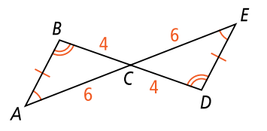
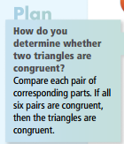
Finding Congruent Triangles:
Are the triangles congruent? Justify your answer.
Given
Definition of ≅ (measures are =)
Vertical ∠s are ≅
ABC
EDC
Yes _______ ≅ _______

Slide 21
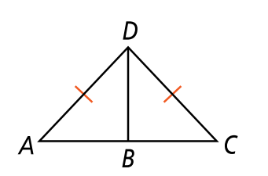
Example 2:
△ABD ≅ △CBD
If m∠A = 3x + 10° & m∠C = 4x°
Find each angle measure:
m∠A = _____
m∠C = _____
3(10)+10 =
40°
3x + 10 = 4x
3x -3x
10 = x
4(10)=
40°

Slide 22
$$∠C ≅∠F$$

Slide 24
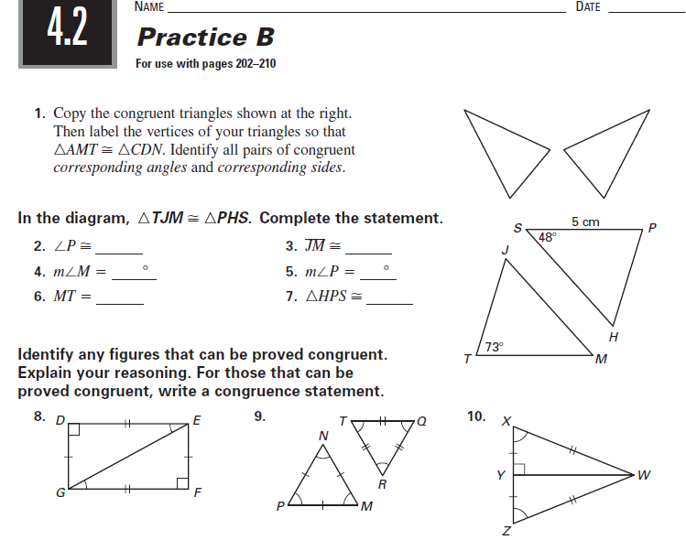

Slide 26
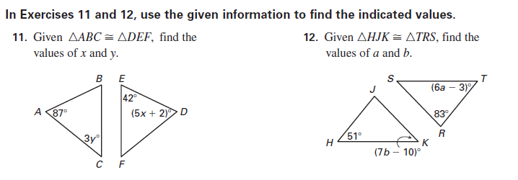

Slide 27
Assignments – HW Check on Monday
4-1 Homework due on Monday

