Slide 1
Geometry Thurs/Fri Nov 1/2nd
You will need your homework and a calculator

Slide 2
Agenda
Warm Up
Go over Homework Answers
Notes on 3.8 – parallel and perpendicular slopes
3.8 Homework
Review (if time)

Slide 3
Slopes of Parallel and Perpendicular Lines
3.8

Slide 4
Objectives
By the end of the period students will be able to:
Determine if lines are perpendicular, parallel, or neither given the slopes of the lines
Write the equation of a line given:
The slope of a parallel line and a point
The slope of a perpendicular line and a point
The equation of a parallel line and a point
The equation of a perpendicular line and a point

Slide 5
Slopes of Parallel Lines.
equal
parallel
parallel

Slide 6
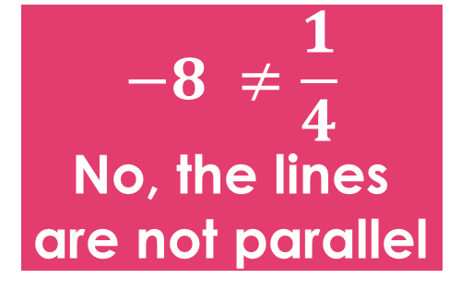
Are the following lines parallel?
Ask yourself,
are the slopes the same?
$$−8 ≠\frac{1}{4}$$
No, the lines
are not parallel

Slide 7
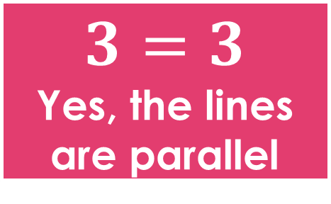
Are the following lines parallel?
$$3=3$$
Yes, the lines
are parallel
The equations of two parallel lines have the same slope, but two different y-intercepts.

Slide 8
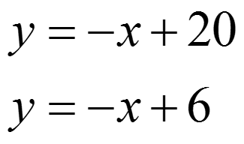
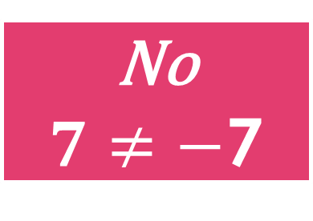
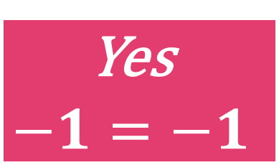
Are the following lines parallel?
Ask yourself,
are the slopes the same?
Yes
$$−1=−1$$
No
$7≠−$7

Slide 9
Perpendicular Lines
-1
perpendicular
perpendicular

Slide 10
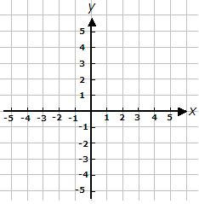
Discovering Slopes of Perpendicular Lines
The lines in both graphs are perpendicular. What is the relationship of each of their slopes?
Slopes: Slopes:
_________ __________
-2 & $\frac{1}{2}$
- $\frac{2}{3}$ & $\frac{3}{2}$

Slide 11
Perpendicular Lines
Slopes of Perpendicular Lines
The slopes of perpendicular lines are
opposite and reciprocals!
$$−\frac{1}{2}$$
$$−\frac{3}{2}$$
$$\frac{1}{7}$$
$$6$$
$$undefined$$
$$−1$$

Slide 12
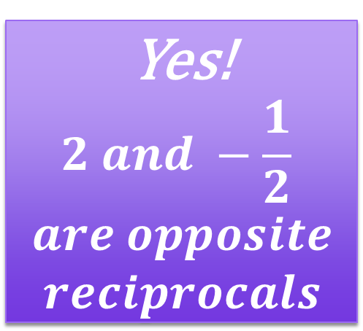
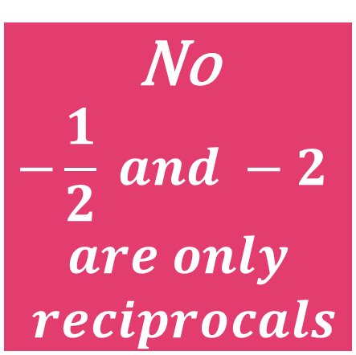
Are the following lines perpendicular?
No
$$2 and −2$$
$$are only$$
$$opposites$$
No
$$−\frac{1}{2} and −2$$
$$are only$$
$$reciprocals$$
Yes!
$$2 and −\frac{1}{2}$$
$$are opposite$$
$$reciprocals$$

Slide 13
I try! Writing an equation of a line.
Write the equation for the line that is parallel to y = -2x+1 and passing through (-2, 3).
Step 1: Find the slope of the equation.
The slope m is -2.
Step 2: Plug in m, x and y to solve for b
Step 3: Plug m and b to get the new equation of your line

Slide 14
We try! Writing an equation of a line.
Write the equation for the line that is parallel to y = -1/2x+10 and passing through (-2, 4).
First, find the slope of the equation. The slope m is -1/2.
The equation of the line is

Slide 15
Writing an equation of a line.
Write the equation for the line that is perpendicular to y = x+1 and passing through (5, 8).
First, find the slope of the equation. The slope m is -1.

Slide 16
Write the equation of the line that passes through (6,-5) and is perpendicular to y = 2x+3.
m = -1/2 and the point is (6,-5)
y = mx+b
-5 = -1/2(6)+b
-5 = -3+b
-2 = b
y = -1/2x-2

Slide 17
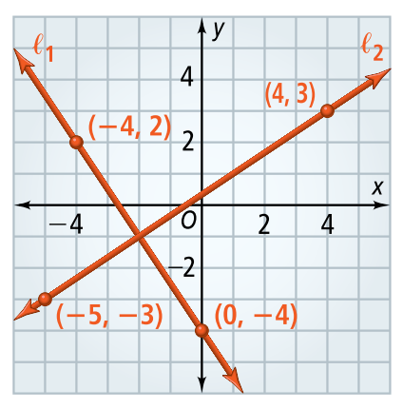
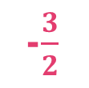
Parallel, perpendicular or neither from a graph
Line l ₁ and l ₂ are neither horizontal nor vertical. Are they perpendicular? Explain.
Step 1:
Find the slope of each line.
Slope of l₁: ______ = __ =
Slope of l₂: _______ = __ =
Step 2:
Compare the slopes.
The slopes are opposite reciprocals, so they are perpendicular.
-4 –
-6
2
-$\frac{3}{2}$
0 –
-4
4
-3 –
-6
3
$\frac{2}{3}$
4
-5 –
-9

Slide 18
Relationship between vertical and horizontal lines
Perpendicular
A vertical line and a horizontal line are:______________
Write the equation of a line perpendicular y = -2 and through the point (1,5)
Write the equation of a line parallel to x = 3 and passes through (-9, 5)

Slide 19
Relationship between vertical and horizontal lines
Write the equation of a line perpendicular x = 8 and through the point (-3, 2)
Write the equation of a line parallel to y = 5 and passes through (5, -7)

Slide 20
Homework 3.8 Due on Monday.

